Slide 1

Forces
Year 11
Pages 242 - 273

Slide 2
Page Setup
Set up the first page of every lesson like this and rule a column line for every page after the first page that is used during the lesson.
Focus: State the Chapter Number, Title and the page numbers (3 lines).
Keywords: During the lesson write out your own keywords used during the lesson. (8 lines)
Context: During the lesson write in this section what this topic relates to in the ‘real’ world. How is this content used to better society? (5 lines)

Slide 3
Force as a Vector
Chapter 8.1
Pages 242 - 246

Slide 4
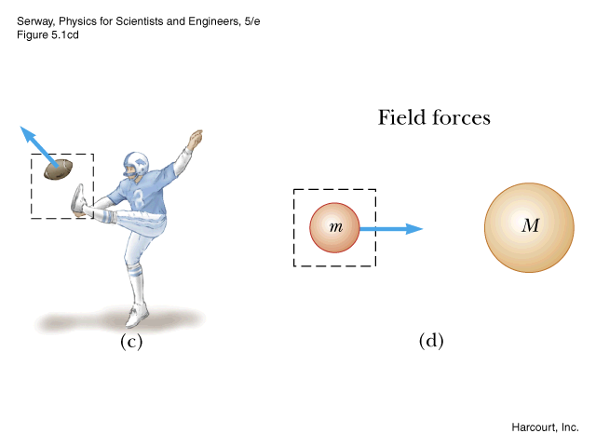
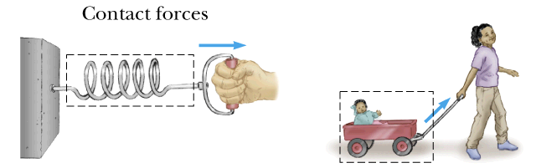
Contact Forces
Involve physical contact between objects.

Slide 5
Contact Forces
Pushing, pulling or twisting are the most common.
Adhesion – a force of attraction between different materials (e.g. Sellotape and paper, or the attraction between water and glass tubing - meniscus).
Cohesion – a force of attraction between particles of the same material (e.g. the attraction between water molecules that become rain droplets).
Surface Tension – a force of attraction between molecules across the surface of a liquid, which can be strong enough in water to support the weight of some insects.
Any force that occurs when two or more bodies actually touch.

Slide 6
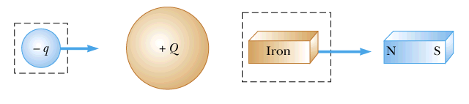
Non-Contact Forces:
No physical contact between objects.
Forces act through empty space.
gravity
magnetic
electric

Slide 7
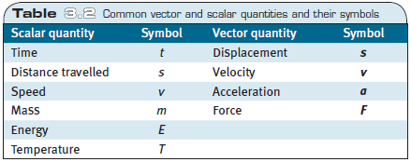
Force = mass x acceleration
Force is a vector quantity.
Recapping:
Mass in a scalar and acceleration is a vector. Since the equation F = ma has a vector quantity, then Force itself is a vector.

Slide 8
One Dimensional Force
The addition and subtraction of Force vectors are the same as the displacement and velocity vectors.
DRAW TO SCALE
Example 8.1 a: A toy car is applied a force of 3N to the East. The friction on the wheels is 1 N. What is the total force applied to the toy car.
Solution
3 N East
=
2 N East
Line of origin
1 N Friction
(opposing force)

Slide 9
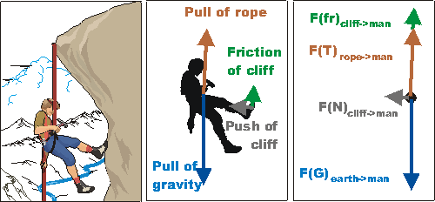
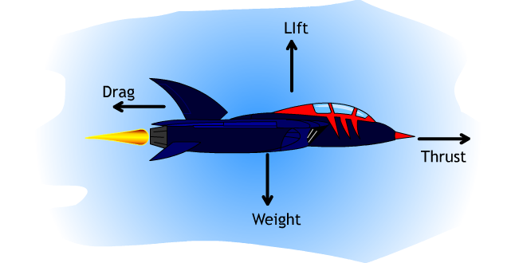
Drawing Forces on an object

Slide 10
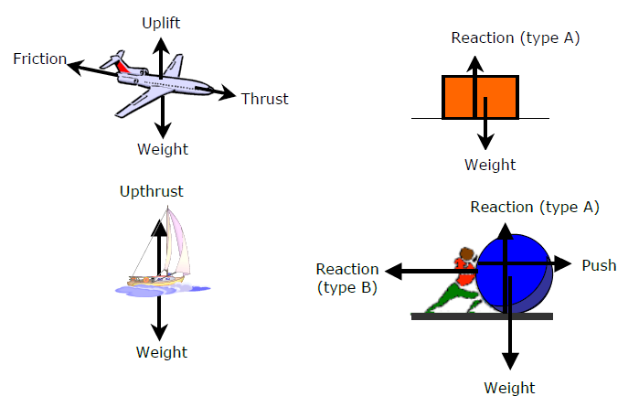
Types of Forces on an object

Slide 11
Types of Forces on an object
Force pairs
Uplift – Weight
Upthrust (Buoyancy) – Weight
Normal (Reaction Type A) – Weight
Thrust – Friction
Thrust (Push) – Reaction (Type B)

Slide 12
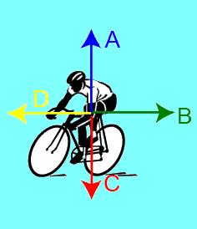
Types of Forces on an object
Example 8.1b
Label the forces
A – Normal (Reaction Type A)
B – Friction
C – Weight
D – Thrust

Slide 13

Types of Forces on an object
Example 8.1c: Draw and label the forces
θ

Slide 14
Homework, Context & Keywords
Context: How is this content used to better society?
The understanding the principles behind force interaction to better explain the fundamentals of forces in action

Slide 15
Homework, Context & Keywords
Key Words
Net force
Contact Force
Non-contact Force
Mass
Balanced Force
Unbalanced Force
Friction

Slide 16
Homework, Context & Keywords
Homework
Complete all questions from Set 8.1 - due first lesson next week.
Read Chapter 8.2, page 247-249 and answer
Q1, 2 & 3 Set 8.2
by next lesson.

Slide 17
Page Setup
Set up the first page of every lesson like this and rule a column line for every page after the first page that is used during the lesson.
Focus: State the Chapter Number, Title and the page numbers (3 lines).
Keywords: During the lesson write out your own keywords used during the lesson. (8 lines)
Context: During the lesson write in this section what this topic relates to in the ‘real’ world. How is this content used to better society? (5 lines)

Slide 18
Gravitational Force
Chapter 8.2
Pages 247 - 249

Slide 19
Weight: F_{g} = m × a
Weight of an object is determined by the gravitational pull on the mass.
All masses have their own gravity; including you.

Slide 20
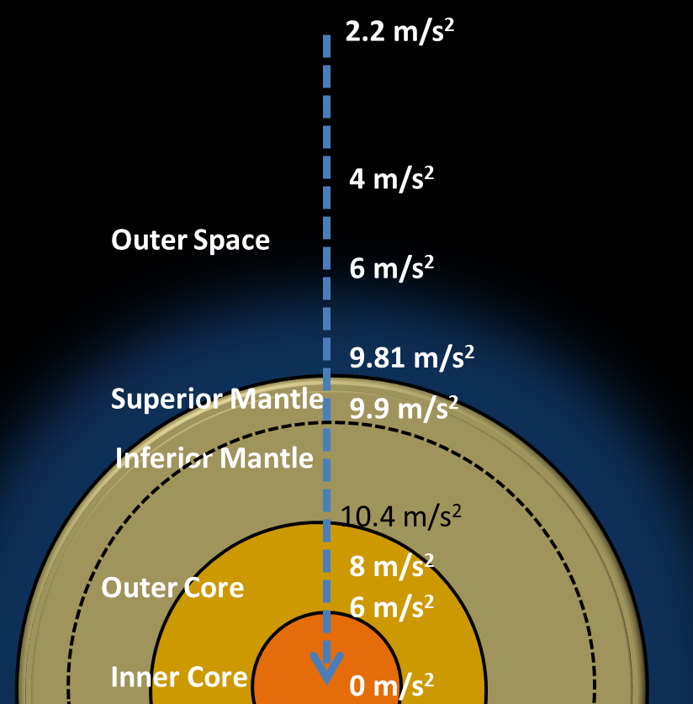
Acceleration on Earth

Slide 21
Acceleration on different planets
On Earth we assume the value for gravity is 9.8 m s⁻², regardless of location on the Earth’s crust.
If a person has a mass of 50 kg, then their weight is
F = m × a
= 50 × 9.8
= 490 N on Earth
What is their weight on the Moon, given the gravity is 1.622 m s⁻²?
F = m × a
= 50 × 1.622
= 81.1 N on the Moon

Slide 22
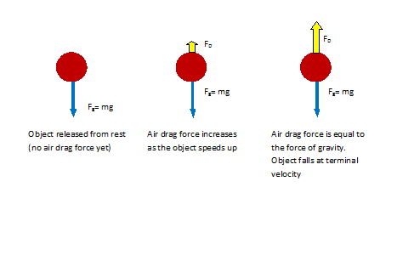
Terminal Velocity

Slide 23
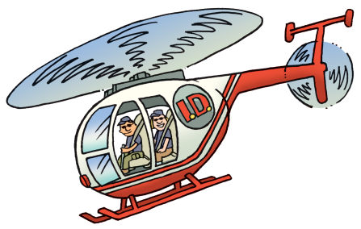
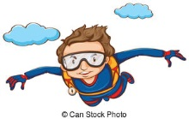
Terminal Velocity
Diagram 1
Diagram 2
Diagram 3
Diagram 4
Terminal Velocity is reached as the forces are no longer unbalanced.
F_{g} = 400 N
F_{g} = 1000 N
F_{g} = 800 N
F_{g} = 1000 N
F_{g} = 1000 N
F_{g} = 1000 N
F_{g} = 1000 N

Slide 24
Homework, Context & Keywords
Context: How is this content used to better society?
The understanding the principles behind gravity to better explain the fundamentals of forces in action.

Slide 25
Homework, Context & Keywords
Key Words
Weight
Mass
Terminal Speed

Slide 26
Homework, Context & Keywords
Homework
Complete all questions from Set 8.2 - due first lesson next week.
Read Chapter 8.3, page 250-257 and answer
Q1 Set 8.3
by next lesson.

Slide 27
Page Setup
Set up the first page of every lesson like this and rule a column line for every page after the first page that is used during the lesson.
Focus: State the Chapter Number, Title and the page numbers (3 lines).
Keywords: During the lesson write out your own keywords used during the lesson. (8 lines)
Context: During the lesson write in this section what this topic relates to in the ‘real’ world. How is this content used to better society? (5 lines)

Slide 28
Newton’s Laws
Chapter 8.3
Pages 250 - 257

Slide 29
Newtons First Law of Motion
An object at rest will stay at rest, and an object in motion will stay in motion at constant velocity, unless acted upon by an unbalanced force.

Slide 30

Newtons First Law of Motion

Slide 31
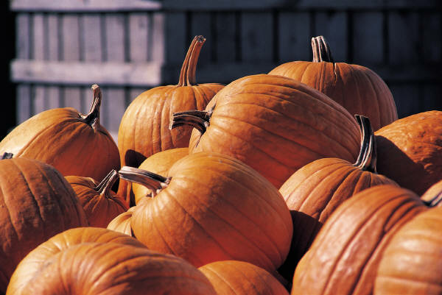
Newtons First Law of Motion
Inertia is the tendency of an object to resist changes in its velocity: whether in motion or motionless.
These pumpkins will not move unless acted on by an unbalanced force.

Slide 32
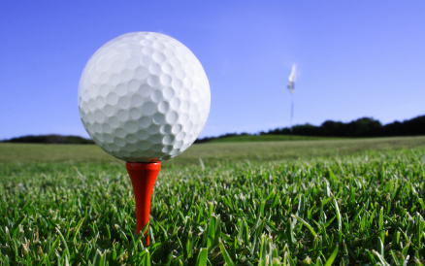
Newtons First Law of Motion
Unless acted upon by an unbalanced force, this golf ball would sit on the tee forever.

Slide 33
Newtons First Law of Motion
Why then, do we observe every day objects in motion slowing down and becoming motionless seemingly without an outside force?
It’s a force we sometimes cannot see – friction.
There are four main types of friction:
Sliding friction: ice skating.
Rolling friction: bowling.
Fluid friction (air or liquid): air or water resistance.
Static friction: initial friction when moving an object.

Slide 34
Newtons First Law of Motion
Don’t let this be you. Wear seat belts.
Because of inertia, objects (including you) resist changes in their motion. When the car going 80 km h⁻¹ is stopped by the brick wall, your body keeps moving at 80 km h⁻¹.

Slide 35
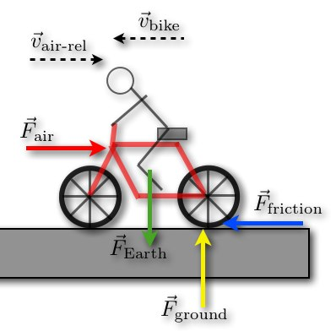
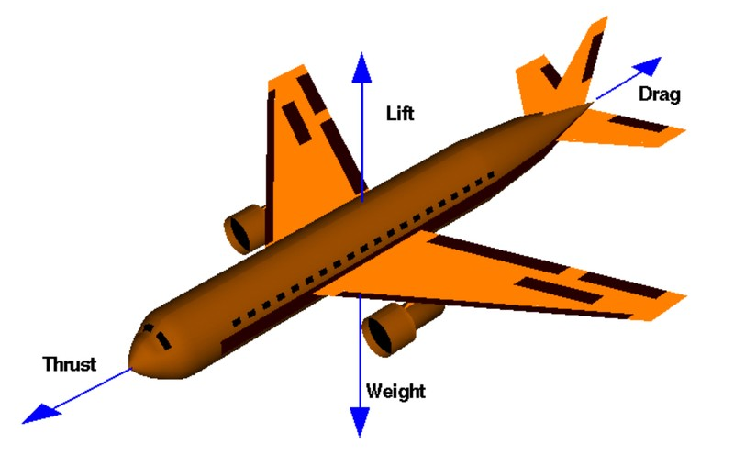
Newtons First Law of Motion
Drawing Vector Diagrams
Example 8.3 a: Draw a vector diagram for the following activities.
Riding a bike at a constant velocity
Abseiling down a cliff
Plane flying at constant velocity

Slide 36
Newtons Second Law of Motion
The acceleration of a body, a, is directly proportional to the net force acting on it, ΣF, and indirectly proportional to its mass, m:
ΣF=ma
Force is measured in Newton's (N)

Slide 37

Newtons Second Law of Motion

Slide 38
Newtons Second Law of Motion
Newton’s 2nd Law proves that different masses accelerate to the earth at the same rate, but with different forces.
We know that objects with different masses accelerate to the ground at the same rate.
However, because of the Second Law we know that they don’t hit the ground with the same force.

Slide 39
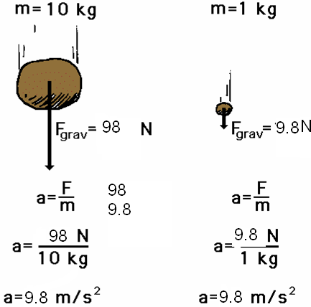
Newton’s Second Law proves that different masses accelerate to the earth at the same rate, but with different forces.
Newtons Second Law of Motion
We know that objects with different masses accelerate to the ground at the same rate.
However, because of the Second Law we know that they don’t hit the ground with the same force.
F = ma
F = 1 x 9.8
= 9.8 N
F = ma
F = 10 x 9.8
= 98 N

Slide 40
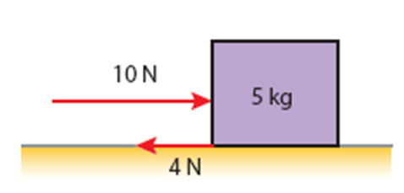
Newtons Second Law of Motion
Example 8.3 b:
A girl pushes a box of mass 5 kg along a frictionless surface with a steady horizontal force of 10N.
What is the acceleration of the box?
(b) If the box is pushed across a rough surface and the friction
encountered is
4 N, what will be
the acceleration
of the box?

Slide 41
Newtons Second Law of Motion
Example 8.3 c:
A medium sized Sedan with passengers and luggage has a mass of 1.15 x 10³ kg. It accelerates from rest to 60 km h⁻¹ in 8.5 seconds. Determine;
Its average acceleration
The average force applied

Slide 42
Newtons Second Law of Motion
The (inertial) MASS of an object is its ability to resist acceleration when the object is acted on by a net force.
Mass is a constant property of the object.
The WEIGHT of a body, W, is defined as the force of attraction on a body due to gravity:
W = mg
where m is the mass of the body
g is the acceleration due to gravity.

Slide 43
Newtons Second Law of Motion
Example 8.3 d: An astronaut on Mars feels a gravitational force of 715 N. If the astronauts weighs 1120 N on Earth, what is the gravity on Mars?
Solutions
F_{mars} = 715 N
F_{earth} = 1120 N
a_{earth} = 9.8 m s⁻²
m = F_{earth}
a_{earth}
= 1120
9.8
m = 114.29 kg
a_{mars} = F_{mars}
m
= 715
114.29
a_{mars} = 6.26 m s⁻²

Slide 44
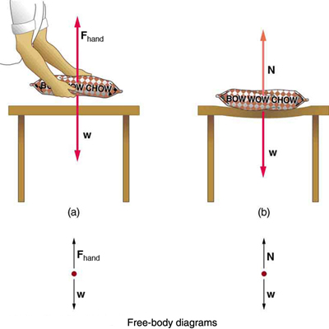
Newtons Second Law of Motion

Slide 45
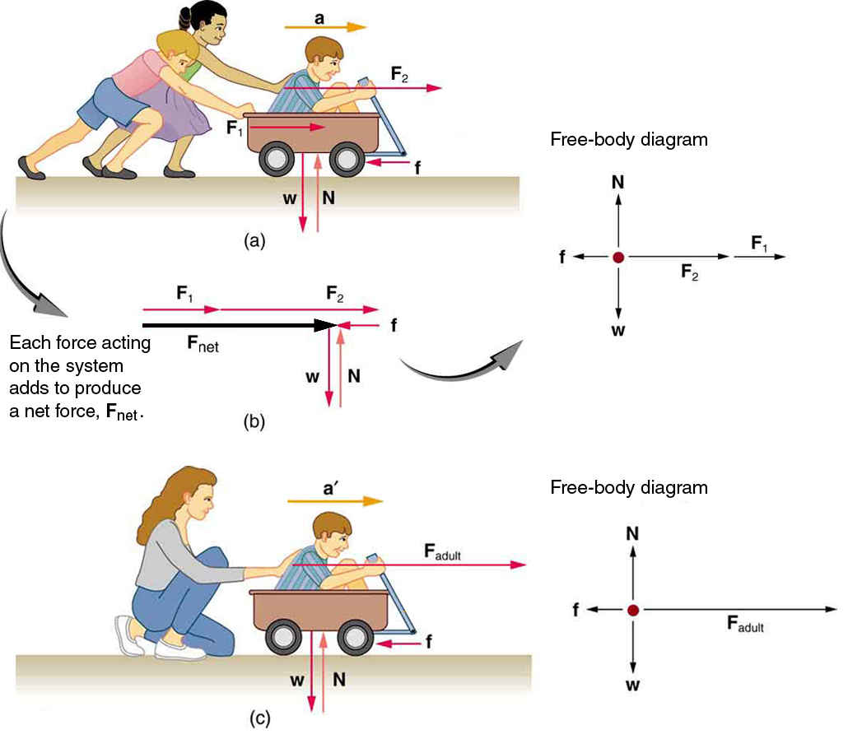
Newtons Second Law of Motion

Slide 46
Newtons Third Law of Motion
For every action force (object A on B), there is an equal and opposite reaction force (object B on A):
F (A on B) = –F (B on A)

Slide 47
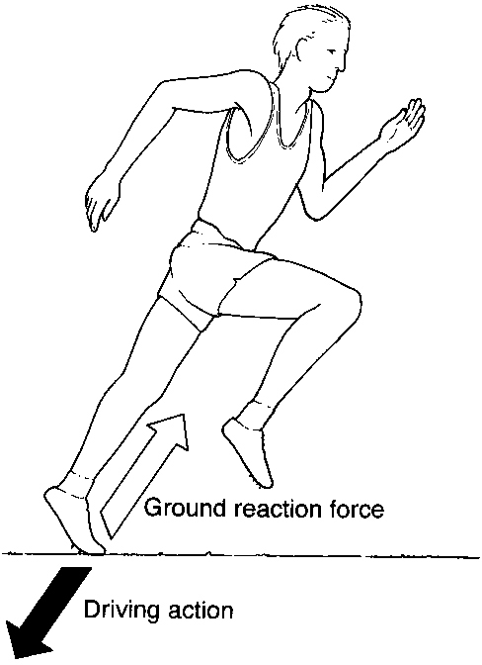
Newtons Third Law of Motion
Walking: your foot exerts a force on the ground (action force) and the reaction force (what the walker actually feels) is the ground exerting an equal force on your foot.
All motion can be explained in terms of
action and reaction force pairs.
Motion | Action Force | Reaction Force
Swimming | Hand pushes back on water. | Water pushes forward on hand.
Jumping | Legs push down on Earth. | Earth push up on legs.
Sky-diving | Force of gravity on the sky-diver from the Earth. | Force of gravity on the Earth from the sky-diver.

Slide 48
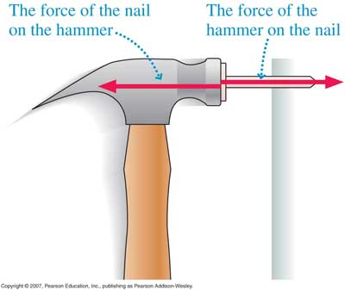
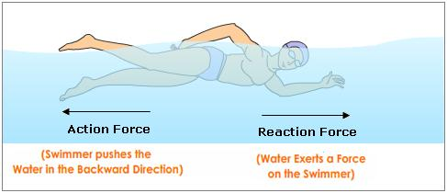
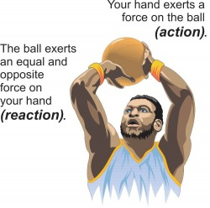
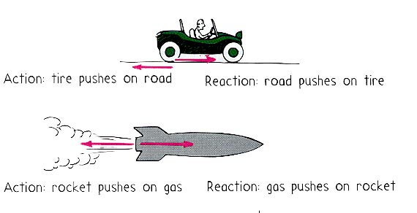
Newtons Third Law of Motion
Pictorially

Slide 49
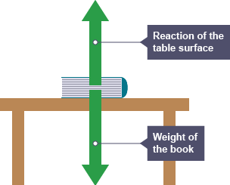
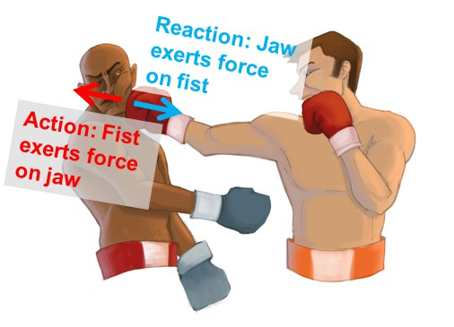
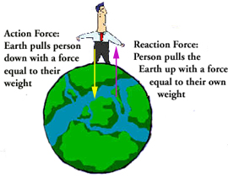
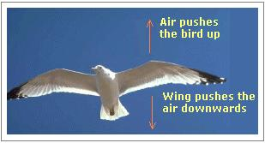
Newtons Third Law of Motion
Pictorially

Slide 50
Homework, Context & Keywords
Context: How is this content used to better society?
The understanding the principles behind Newtons Laws to better explain the fundamentals of forces in action and motion.

Slide 51
Homework, Context & Keywords
Key Words
Weight
Mass
Force
Inertia
Friction
Net Force
Reaction Force
Action Force
Unbalanced
Fluid Friction
Static Friction

Slide 52
Homework, Context & Keywords
Homework
Complete all questions from Set 8.3 - due first lesson next week.
Read Chapter 8.4, page 258-273 and answer
Q1 & 2 Set 8.4
by next lesson.

Slide 53
Page Setup
Set up the first page of every lesson like this and rule a column line for every page after the first page that is used during the lesson.
Focus: State the Chapter Number, Title and the page numbers (3 lines).
Keywords: During the lesson write out your own keywords used during the lesson. (8 lines)
Context: During the lesson write in this section what this topic relates to in the ‘real’ world. How is this content used to better society? (5 lines)

Slide 54
Two Dimensional Force Diagrams
Chapter 8.4
Pages 258 - 273

Slide 55
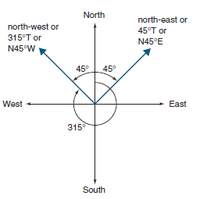
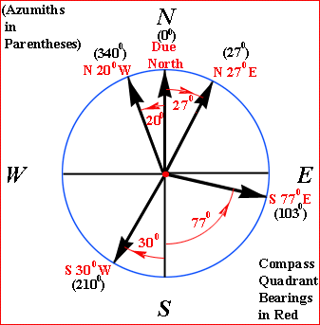
Bearing and Directions
and
Example 8.4 a: Identify the Bearing and
Direction of
the following.
Bearings
045ºT
315ºT
Directions
N45ºE
N45ºW

Slide 56
Net Force
Net Force is the vector sum of all forces acting on a object simultaneously.
ΣF = F₁ + F₂ + F₃ + ... + F_{n}
Force is a vector and therefore the direction is crucial in understanding the affects the combination of forces have on an object.

Slide 57
Two Dimensional Vectors
Graphical representation of vector forces must be to scale.
Draw all vectors to correct magnitude and direction.
Draw all vectors tail to head.
The resultant vector will run the shortest path from the origin tail to the head of the final vector.

Slide 58
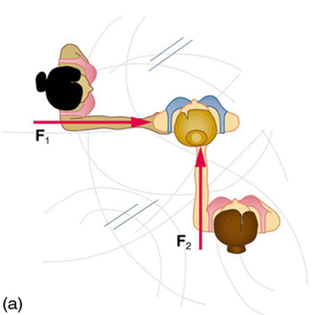
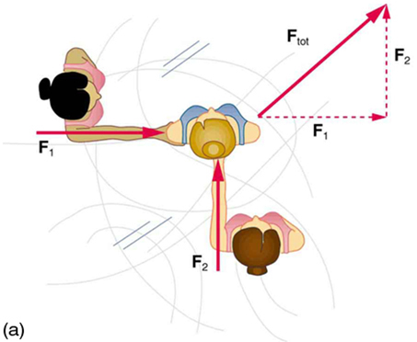
Two Dimensional Vectors
Example 8.4 b: Carol (blonde hair) is standing between Bonny (black hair) and Annette (brown hair). If Annette pushes Carol with a force of 15 N and the same time Bonny pushes Carol with a force of 25 N, then what force does Carol experience?
Draw the vector diagram
Calculate the resultant force.
ΣF = F₁ + F₂
F_{tot} = √15² + 25²
= 29.15 N
φ = 30.96º

Slide 59
Multiplication of Vectors
Example 8.4 c:
Find 2A
Find -2A
Find ½B
Find 4B
A
B
16 N
10 N
30º
25º

Slide 60
Two Dimensional Vectors
Example 8.4 d:
For each question, draw the vector diagram.
Add A + B
Add C + D
A
B
55 N
C
D
40º
65 N
70 N
30 N
50º
60º
30º

Slide 61
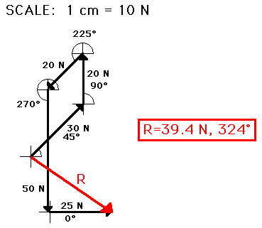
Two Dimensional Vectors
Having a large number of vectors to add together can make the whole addition of vectors very complex.
A simple method is to break each vector into its horizontal and vertical components (convert to x – axis and y – axis equivalent).
Then add all the x – axis
equivalent together and add
all the y – axis equivalent
together and use Pythagoras
to solve the resultant of two
components, rather than several.

Slide 62
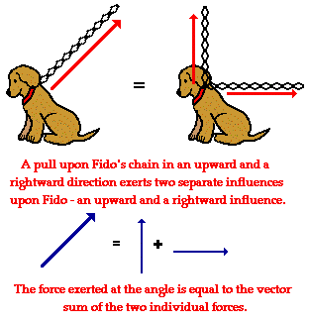
Two Dimensional Vectors
The horizontal and vertical components (x – axis and y – axis equivalent) are the same as the singular Resultant force.

Slide 63
Two Dimensional Vectors
Example 8.4 e:
What is the horizontal and vertical components for the following.
Add A + B + C + D
Add A + C
A
B
C
D
70 N
65 N
20º
30 N
55 N
50º
60º
45º

Slide 64
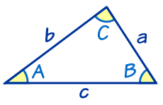
Cosine Rule
a² = b² + c² – 2 b c Cos(A)
Example 8.4 f:
Add the two vectors (A + B)
Subtract the two vectors (A – B)
A
B
16 N
10 N
30º
25º

Slide 65
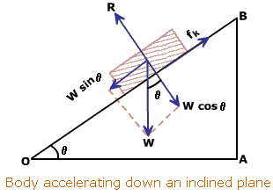
Inclined Planes
Inclined Plane
W sinθ
W
W cosθ
If W sin θ = f_{k}, then the object has constant velocity.
θ

Slide 66
Inclined Planes
Example 8.4 g: Car of mass 650 kg is parked on a hill of angle 40º from horizontal. What is the frictional force and normal action force.

Slide 67
Lift Systems
Example 8.4 h: Sally has a mass of 55 kg. She enters the express lift up to the 20th floor, before changing to the general lift to go down to the 17th floor.
a) What is her weight before entering the lifts.
b) If the lift is travelling with a constant velocity, what net force will Sally experience?
c) The lift accelerates from rest at 3 m s⁻² upwards. What force would she feel?
d) The lift accelerates from rest at 2 m s⁻² downwards. What force would she feel?

Slide 68
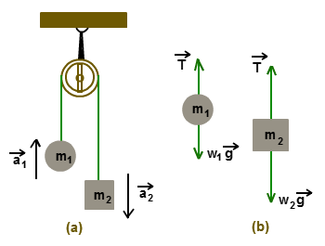
Pulley Systems
Tension has no direction, it is assumed to be in line with the direction of the object being stretched.
Example 8.4 i: If m₁ is 10 kg and m₂ is 15 kg.
a) Find the acceleration of this pulley system.
b) Find the tension
created by the 15 kg
mass.
c) What is the tension
on the rope in this
pulley system.

Slide 69
Homework, Context & Keywords
Context: How is this content used to better society?
The understanding the principles behind Multiple Forces to better explain the fundamentals of forces in action and motion.

Slide 70
Homework, Context & Keywords
Key Words
Drag Force
Normal Force
Resultant Force
Inclined Planes
Addition of Force Vectors
Weight

Slide 71
Homework, Context & Keywords
Homework
Complete all questions from Set 8.4 - due first lesson next week.
Read Chapter 9.1, page 280-282 and answer
Q1,2 & 3 Set 9.1
by next lesson.
Chapter 8 Review due first lesson next week.

